Slide 1
EDA Mental Health in Tech Survey
Ironhack | Data Analytics Bootcamp | Silvia Nicolau | Feb 2020

Slide 2
Main questions ?
Which are the sub-groups of pepole with a MH condition?
Which are the employment factos that influence having a MH condition the most?

Slide 3
Workflow
Read Data
Data overview – check rows and columns, types, nulls and values
Clean Data
Remove timestamp and comments
Normalize age records
Analyse Data - MVP
MH condition by country
Analyse Data – Deep
Dive
Influence of self-employment
Interpret country and state (and remove the non-relevants)
Normalize gender records
MH condition by age
MH condition by gender
Influence of remote work
Influence of tech company

Slide 4
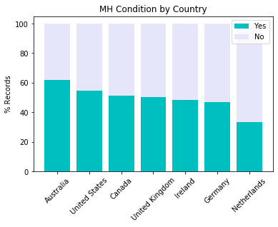
MH Condition by Country
From the sample of countries surveyed, the country with more people with MH condition is Australia and the one with less is The Netherlands.
In general about 50% of the people do have a MH condition which is a very significant insight itself.

Slide 5
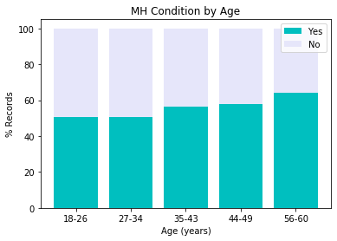
MH Condition by Age
The age is grouped by ranges to get a clearer insight, using the mean of records.
The chart shows a slightly increasing tendency of MH condition with age.
It would be interesting to have records from people over 60 to confirm this tendency.

Slide 6
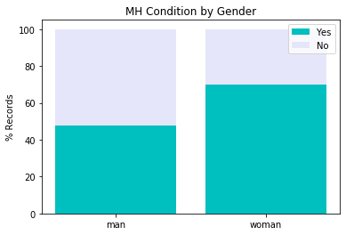
MH Condition by Gender
There are more woman with MH condition than man.
Although this chart is done with the weighted records of woman and man, it’s importante to note that there are almost 4 times more records from man than from woman.

Slide 7
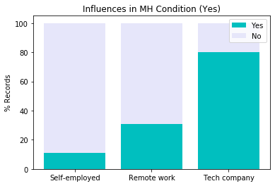
Influence of employment factors
Among the people with a MH condition there are few self-employed, some working remotely and many working in a tech company.
So there seems to be a strong direct relation between having a MH condition and working in Tech!

